Slide 1
MINI PROJECT
ON REGRRESION
PREPARED BY – JITENDRA GIRISH PATIL

Slide 2
MINI PROJECT ON REGRESSION
TABLE OF CONTENTS –
Explanation of what the project is all about ?
Describing the data : Its source, datatypes, description and information.
Data Pre - Processing techniques used, How the missing value is handled and Feature engineering techniques used.
EDA and the interpretations from your visualizations.
Model building : whether used one model or more, Algorithms used in the model and the reason for choosing it and Cross validation result if used.
Evaluation of the performance of the models, and final conclusion of best model which can be used.

Slide 3
What the project is all about...
One thing is important in sales that is Happy customers which happens only if the sales is more and shop provides better hospitality. To enable this, store owners rely heavily on past data to predict future sales. This will help them in strategizing their business models and come up with innovative techniques and ideas to attract customers.
Many medium to large stores implement this kind of analytics to understand trends like which products are getting sold faster, what are the slow moving products, impact of store types, etc.
To get the better results for store owners, building a model to predict the sales in store is necessary and this project is all about prediction of sales.

Slide 4
Describing the Data
The data contains total 14204 rows and 12 columns. Following are the columns and dtypes
FEATURE | DATA TYPE | DESCRIPTION
Item_identifier | Character | Unique Product ID
Item _weight | Numeric | Weight of the product
ltem_Fat_Content | Numeric | Total fat content in the product
Item_Visibility | Numeric | How visible is the product in the store
Item _Type | Numeric | Product category of the selected product
Outlet_Identifier | Categorical | Store ID
FEATURE | DATA TYPE | DESCRIPTION
Item_MRP | Numeric | Product Cost
Outlet_Establishment_Year | Numeric | Year
Outiet_Size | Categorical | Store size type
Outlet_Location_Type | Categorical | Location type where the store is located
ltem_Outlet_Sales | Numeric | Sales made by the store outlet
Outlet_Type | Categorical | The type of store

Slide 5
Data Pre-Processing Techniques
Null Value Treatment - In Pre-Processing, First of all we checked for empty values, there were 5681 empty values in Item_Outlet_Sales, so to tackle these missing value, missing value treatment has been done by KNN Imputer which works on the logic of Nearest Neighbors and manually grouping the data on the basis of Outlet Type.
4 types of Outlet type were there, Grocery Store, Supermarket Type1, Supermarket Type2 and Supermarket Type3. So, on the basis of these groups, the mean of every type sales value is taken and imputed the data GroupWise.
Label Encoding - Then the non numeric data type feature were converted into numeric type as the machine understands numeric values very well using the method(Label Encoder).

Slide 6
Data Pre-Processing Techniques
Feature Scaling - The data is then scaled(converted into a certain range) using the function MinMaxScaler(used to normalize the values of columns between 0 and 1) for easy and fast processing.
Feature Selection - For feature selection, on the basis of relation between multiple columns with Item_Outlet_Sales we determine the best correlated columns and then they were selected for further modelling of different algorithms.
Splitting the data – The data is splitted between Training data which is used to train the model and test data

Slide 7
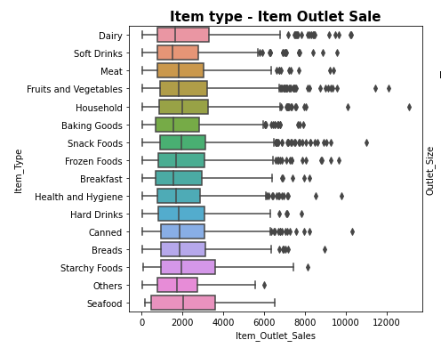
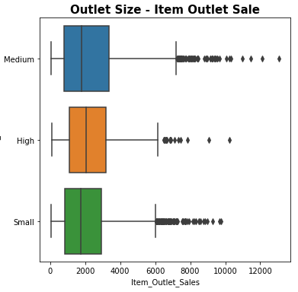
Exploratory Data Analysis
Interpretation :
Here we can see that the Starchy Foods have the most number of outlet sales
The outlet size have maximum sales in medium size outlet from 1K to 3.5K.

Slide 8
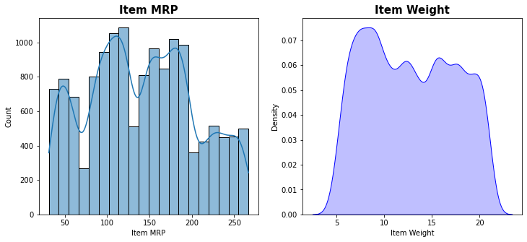
Exploratory Data Analysis
Interpretation :
The Item MRP of 100-120 have the highest count of around 1000 and least for MRP 260 with 250 counts.
The Item weight 6-7 have most count.

Slide 9
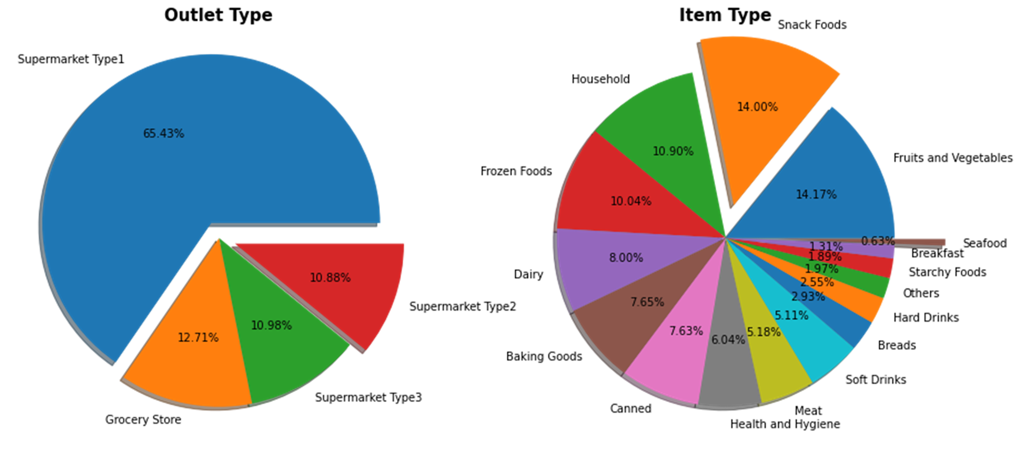
Exploratory Data Analysis
Interpretation :
Supermarket Type1 have the highest share 65.43% in the outlet type.
Snack Foods have the highest percentage in item type which is being sold and sea food have the least 0.63% percentage.

Slide 10
Model Building
There were total 4 models used to get the best model which can give the best performance and prediction. Following are the models
Linear Regression Model
Random Forest Regression
Stacking Regression
Decision Tree Regression
The main motive to use these models was to get best Performance from the model and compare them. As the target attribute is continuous, use of Regression Algorithm will be the best option. Prediction has been calculated using the testing data and For evaluation of model, Mean Squared Error and Root Mean Squared Error are used.

Slide 11
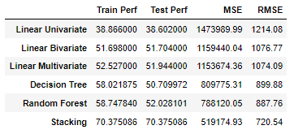
Evaluation and Final Conclusion of Model
Final Conclusion -
There were 4 models prepared for getting the best performance and prediction, Linear Regression, Decision Tree Regression, Random Forest Regression and Stacking Regression.
Stacking Regressor can be said as best model among other models.
As the Performance is comparatively good than other models and Training and Testing Performance is also matching.
The MSE and RMSE errors are less than the other models.
Even though the Stacking Regressor is best among other models, the performance is not good enough and giving us 70% of performance. It is because the target column have ~40% of null values and imputing the data using imputation technique can give us biased data.

Slide 12
Business Implications -
We can see Starchy Foods have most of the sales among other food type and the outlet with starchy food will be beneficial for the sales as most of the customers prefer and cold drinks are preferred the least.
Most of the outlet size is medium so, Medium category have the maximum range from 1000 sales to 7000 sales and small outlet have least sales.
If the outlet type is supermarket especially Supermarket type1 it have the highest count in the sales than any other type of outlet followed by Grocery Store.
If the item MRP is kept between 100-120 there is a high chance that the sales will be more.
Sales is high if Visibility is around 0.02-0.03 and least for 0.3.
In Item Outlet Sales graph, Most of the sales is of 1000 which is counting up to 1600.
Snacks are most popular item which the customers consumes. Having snacks at the market will be a great way to increase the sales

Slide 13
THANK YOU

